Slide 1
Securing understanding of ratio as a multiplicative relationship
Task A: Reviewing ratio
1a) Construct a ratio table for the following recipes.
1 vanilla cake
250 g of flour
2 eggs
10 ml of vanilla
75 g of sugar
75 g of butter
1 banana cake
200 g of flour
2 eggs
3 bananas
200 g of sugar
200 g of butter
1 grapefruit cake
125 g of flour
1 egg
1 grapefruit
300 g of sugar
150 g of butter
b) For each cake, how many cakes can you make with 1 kg of flour and how much of each other ingredient is needed?
‹#›

Slide 2

Securing understanding of ratio as a multiplicative relationship
2) Jacob has spilt chocolate sauce all over his ratio table for making chocolate brownies. Work out the missing values.
Serves (people) | Butter (g) | Cocoa (g) | Sugar (g) | Eggs | Flour | Vanilla extract (ml)
10 | 200 | 200 | 175 | 3 |  | 10
5 |  | 100 | 87.5 |  | 50
20 |  |  |  | 6
 | 300 | 300
3) Identify if each statement is true or false for the following using this ratio table.
Burger | Veggie patty (g) | Lettuce (slices) | Cheese slice | Tomato slice
1 | 120 | 2 | 3 | 4
Statement | T | F
For every 4 slices of lettuce there are 6 slices of cheese.
Tomato slices are double the lettuce slices.
For every 60 g of veggie patty, there are 2 slices of tomatoes.
v2.1

Slide 3
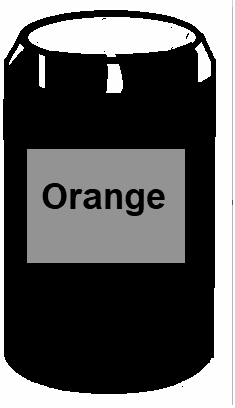

Securing understanding of ratio as a multiplicative relationship
Task B: Using reasoning with ratios
1) Laura has a recipe for lemonade. It is the perfect mix of water, lemon and sugar. “For every 1 lemon, use 500 ml of water and 2 tablespoons of sugar.”
Fill in the table below to identify if the ratios below give a mixture that is too sweet (too much sugar), too bitter (not enough sugar) or perfect.
Ratio | Too sweet | Too bitter | Perfect
2 lemons, 1000 ml of water and 3 tablespoons of sugar
4 lemons, 2000 ml of water and 9 tablespoons of sugar
3 lemons, 1500 ml of water and 6 tablespoons of sugar
2) Orange paint is made using 2 tins of yellow for every one tin of red.
Sam, Jacob and Aisha are given an orange paint made in this ratio.
They each add three more tins to the mix, using only red and yellow.
The results after they mixed the extra tins are below.
What colours were in each of their three tins?
Sam’s paint turns lighter.
Jacob’s paint stays the same colour.
Aisha’s paint turns darker.
Sam
Jacob
Aisha
‹#›

Slide 4
Securing understanding of ratio as a multiplicative relationship
Task B: Using reasoning with ratios
3) Tick if the statement is true or false.
Statement | True | False
A ratio describes the relationship between values.
Ratio uses an additive relationship.
Adding the same amount to each part in a ratio keeps the ratio the same.
Multiplying by the same amount for each part in a ratio keeps the ratio the same.

